Slide 1
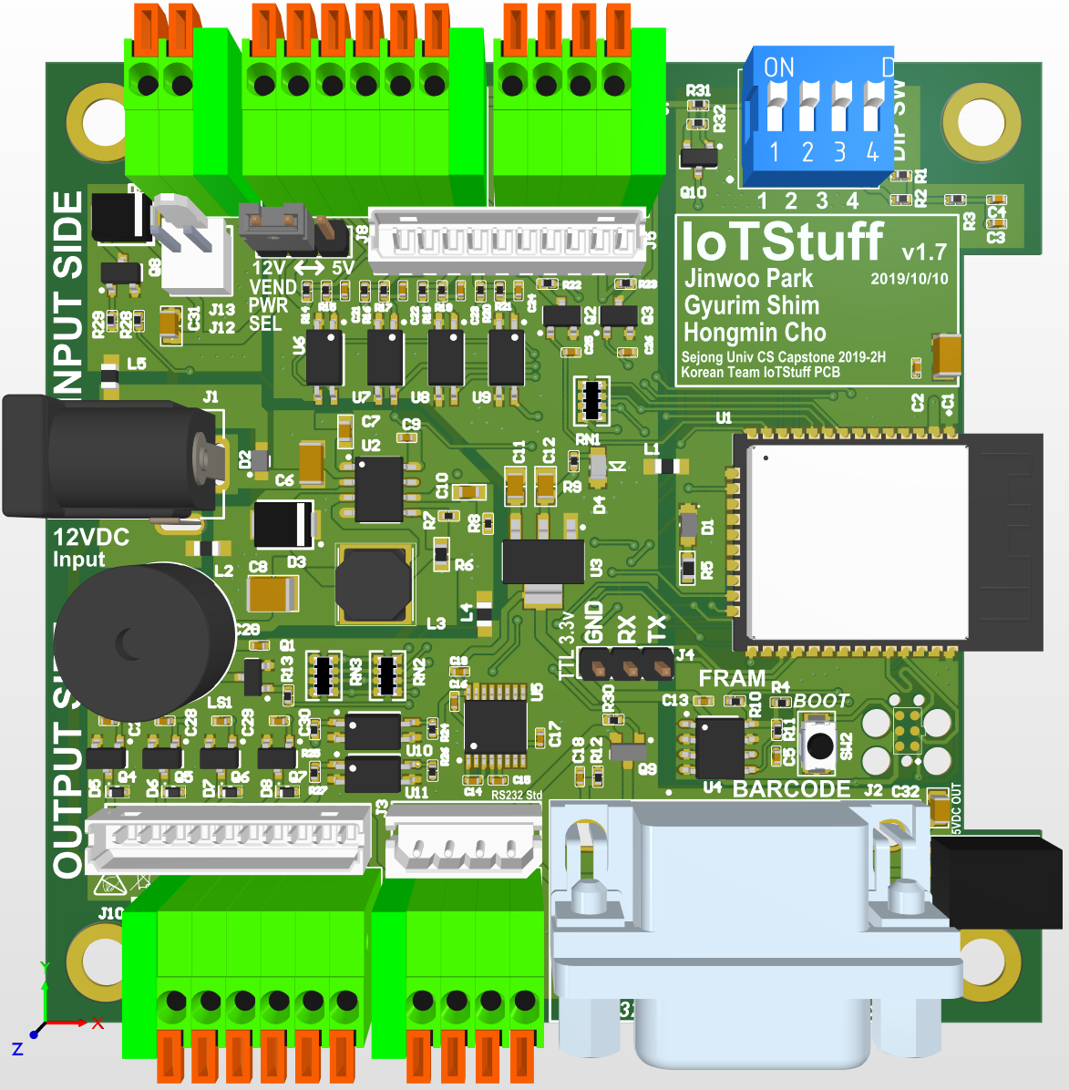
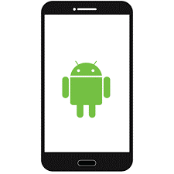
Capstone Design Project IotStuff – Bluetooth Mesh
14011058 Jinwoo Park
14011080 Gyurim Shim
15010990 Hongmin Cho

Slide 2
Concept of IoTStuff
It is one of a product project that including hardware and software development both.
It extend legacy home electronics or facilities to IoT world with semi-industrial level hardware interface.
IoTStuff will have semi-industrial level hardware that have a safe interface of Input/Output system.

Slide 3
Project Description
Light bulb, normal electronics that can be controlled by normal switching.
And not only turn on or off, User or system control things with time-domain. This lead to power-saving or programmable control for home-automation or industrial usage.

Slide 4
Developing Process
Hardware Develop
Schematic
CAD (Gerber)
Communication system
Firmware
Android
Android App
Interface
Combination
There are 3 big flow of progress for this project.

Slide 5
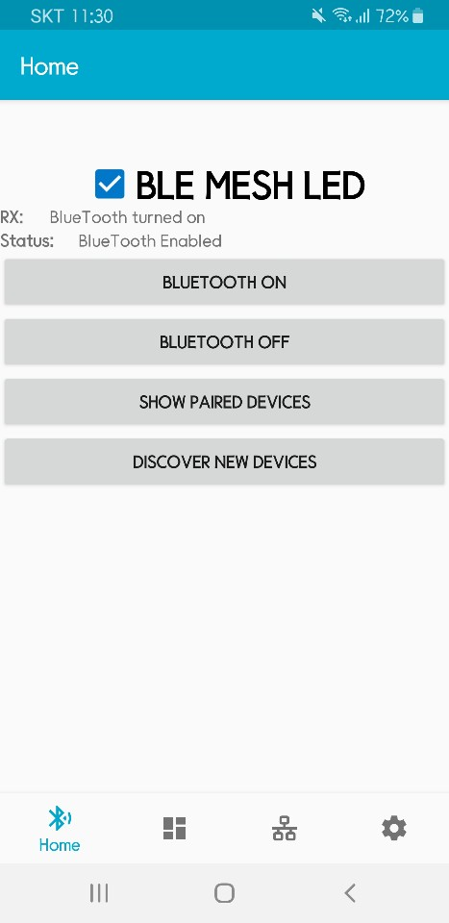
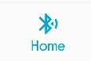


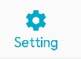
Application introduce
Background color blue
4 Fragments

Slide 6
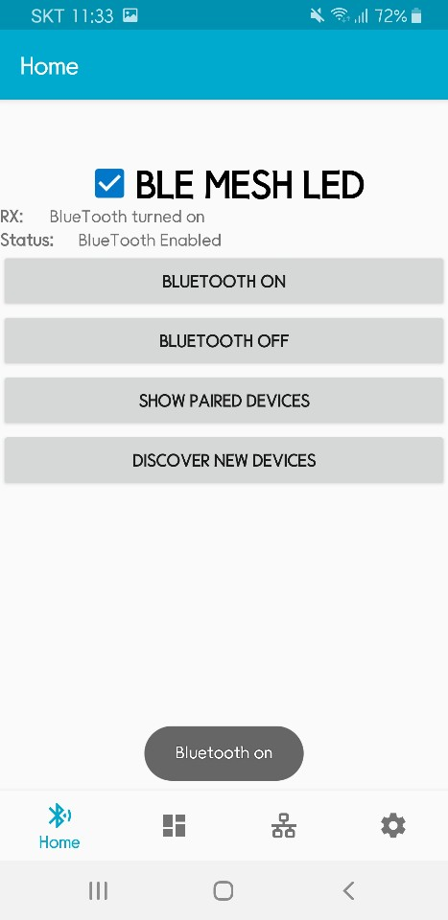
Home Fragment
Bluetooth on & off
With check box
With toast message

Slide 7
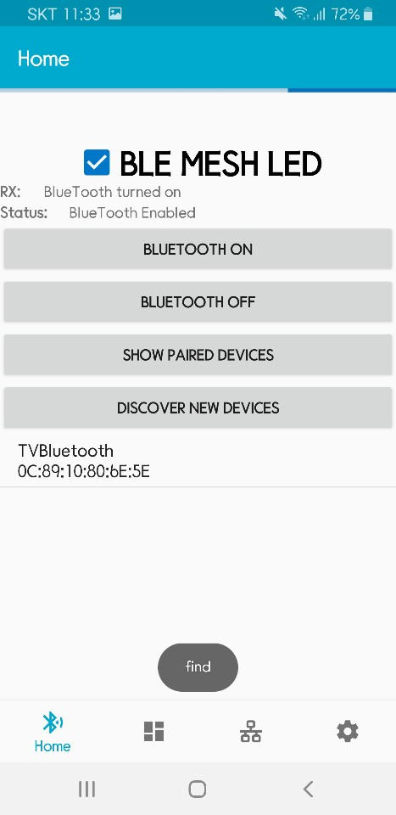
Home Fragment
Discover new devices
Find Bluetooth equipment

Slide 8
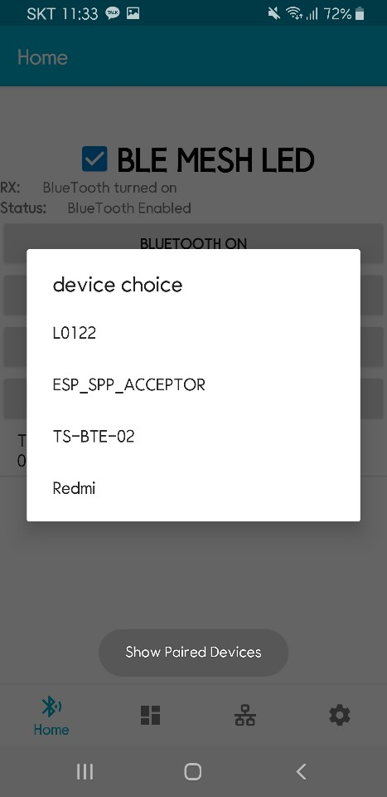
Home Fragment
Show Paired devices
Tab the button, connect

Slide 9
Home Fragment
Use indeterminate progress bar
Check status discovery

Slide 10
Home Fragment
Device Paring

Slide 11
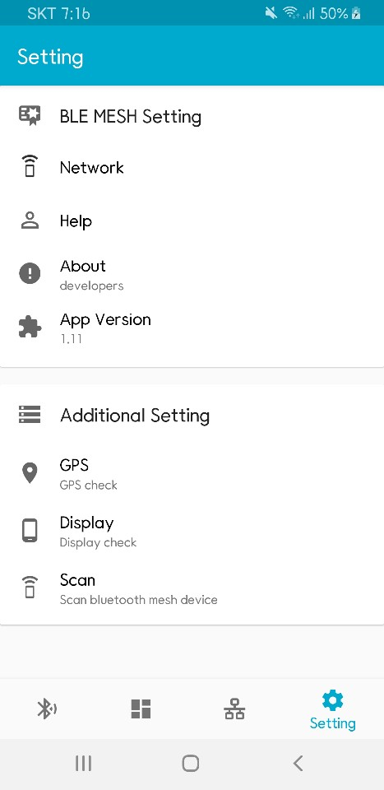
Setting Fragment
Using Card view, toolbar, include
Ble mesh setting
additional setting

Slide 12
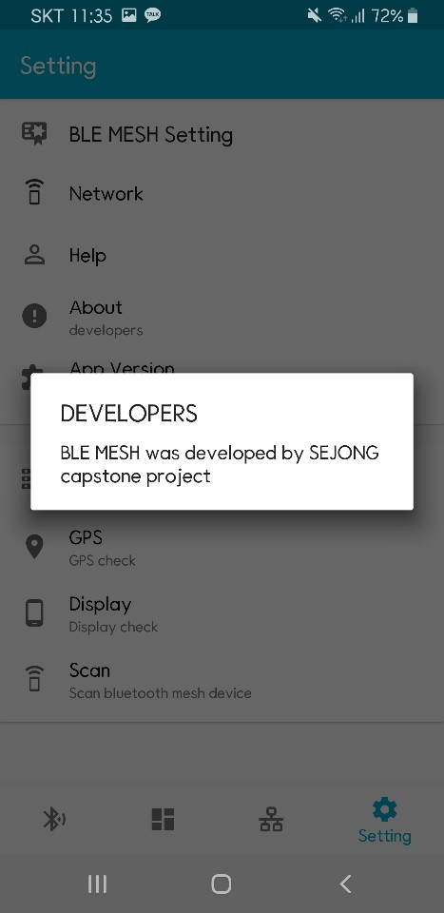
Setting Fragment
Check developers

Slide 13
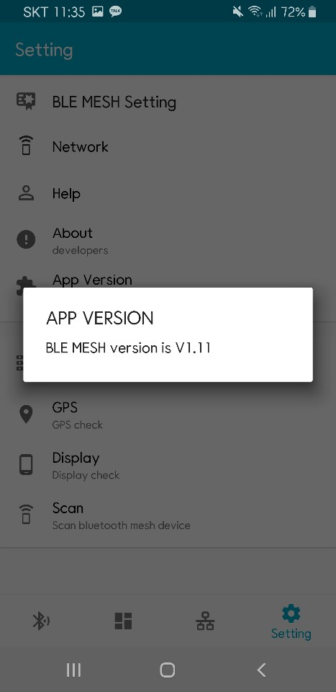
Setting Fragment
Check App version

Slide 14
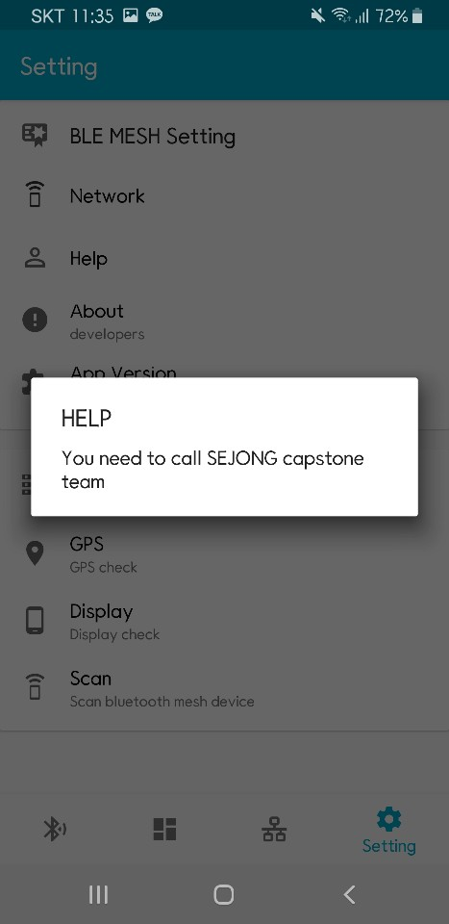
Setting Fragment
Check Help

Slide 15
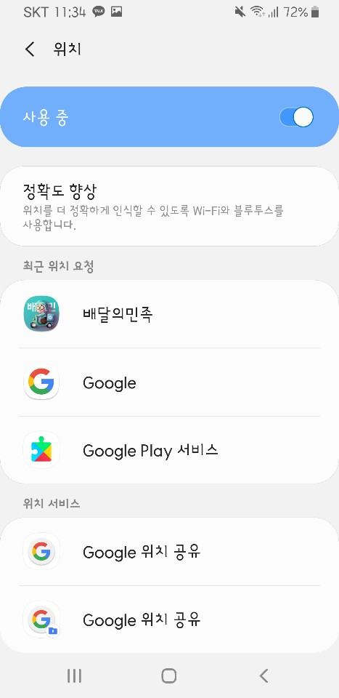
Setting Fragment
GPS setting
Inherent in the user's phone

Slide 16
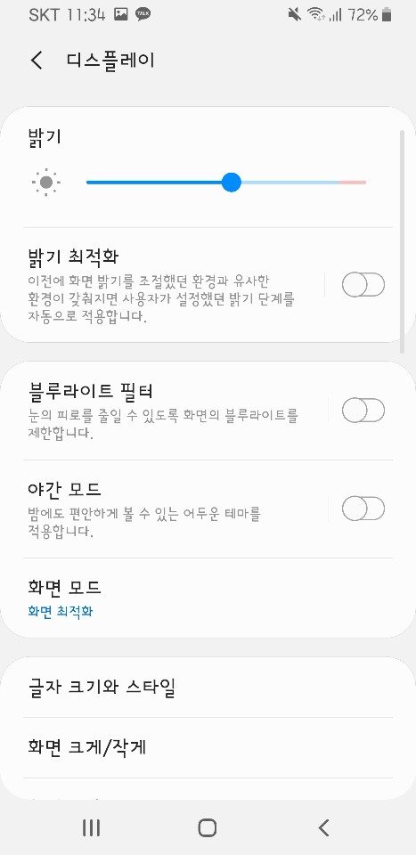
Setting Fragment
Display setting
Inherent in the user's phone

Slide 17
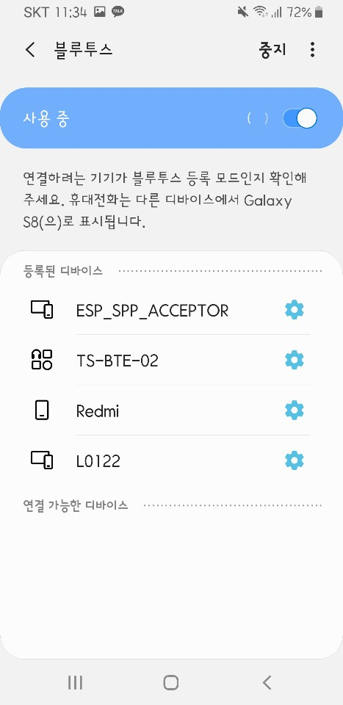
Setting Fragment
Bluetooth setting
Inherent in the user's phone

Slide 18
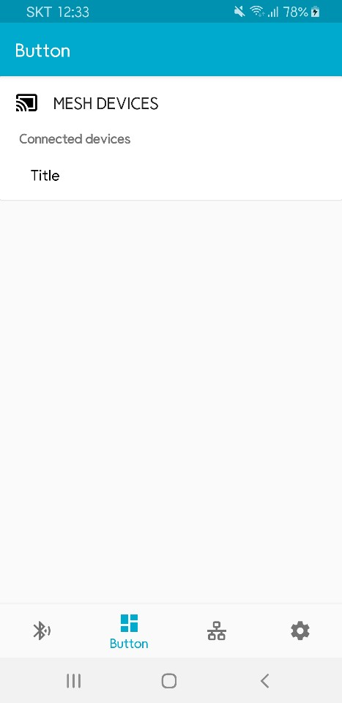
Button Fragment
Using card view, toolbar, include
Kyurim will talk about detaild functions and communication

Slide 19
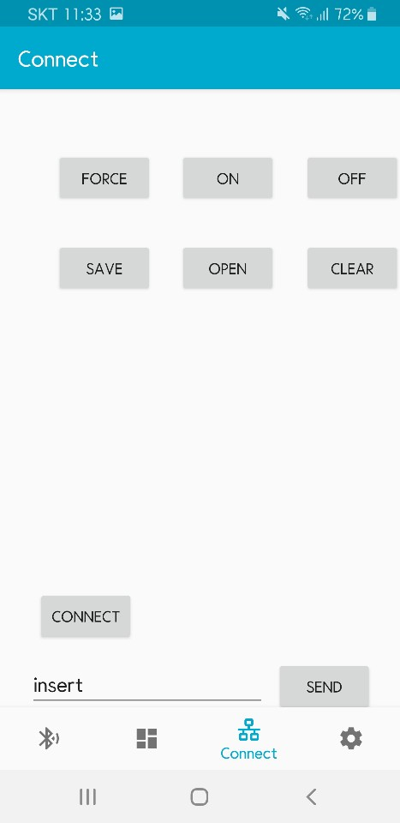
Connect Fragment
problem with dynamic design

Slide 20
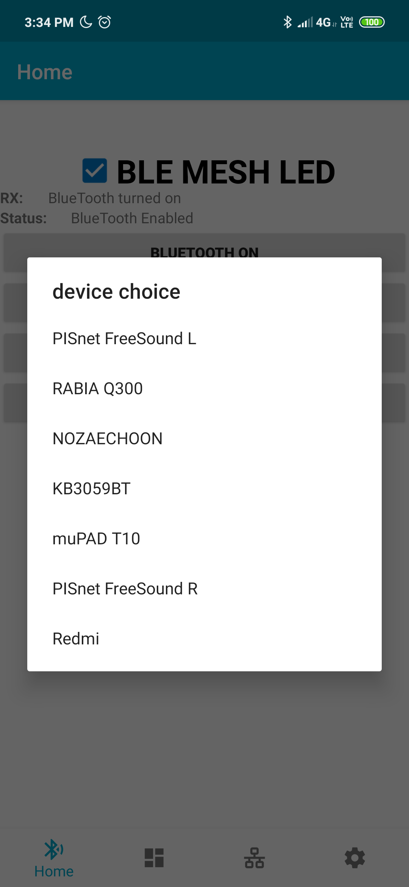
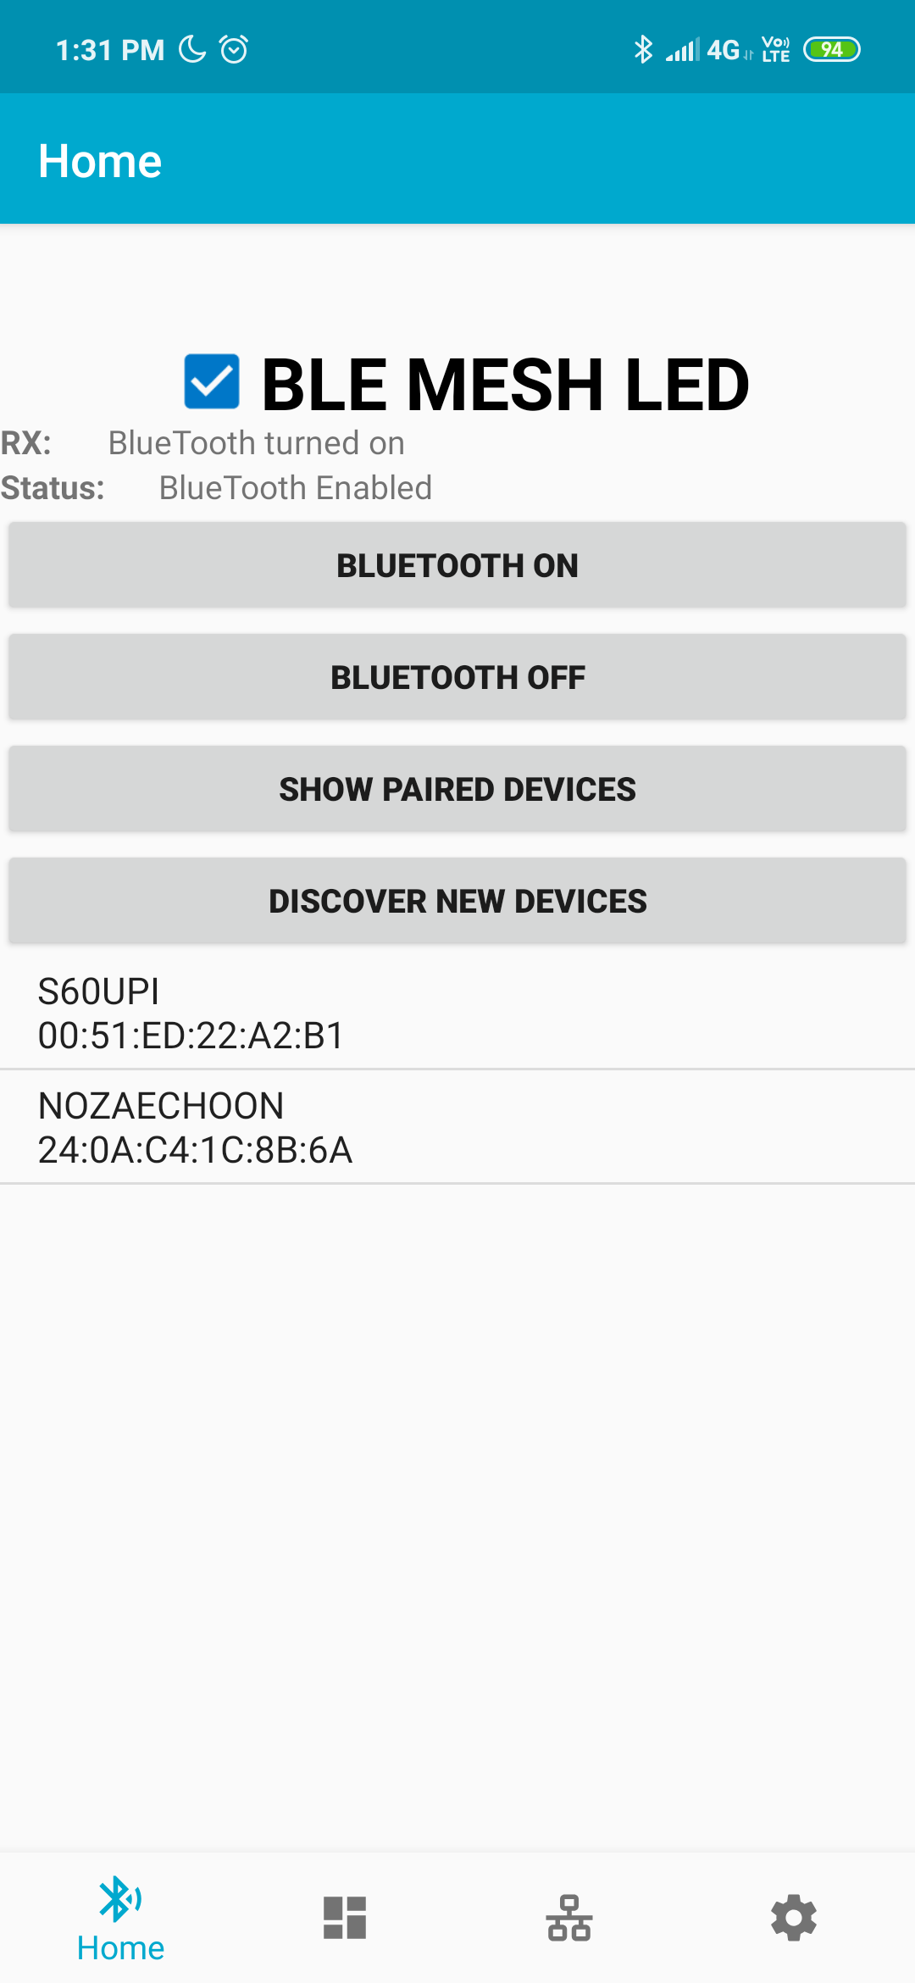
Developing Process
At first, we only have Paired Device List.
But it is so bothers us, because we have to manually add Bluetooth device in the android Bluetooth tab.
So we implemented discover function.
Paired Device List
Discover New Devices

Slide 21
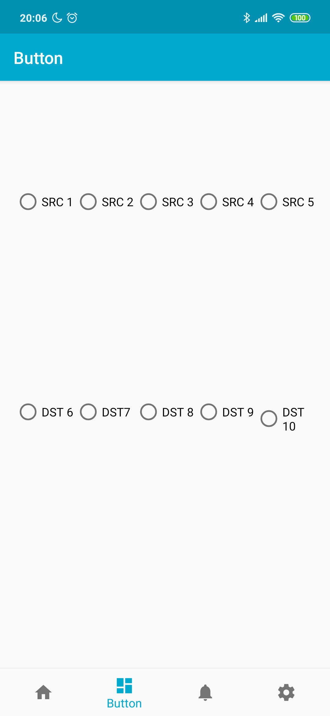
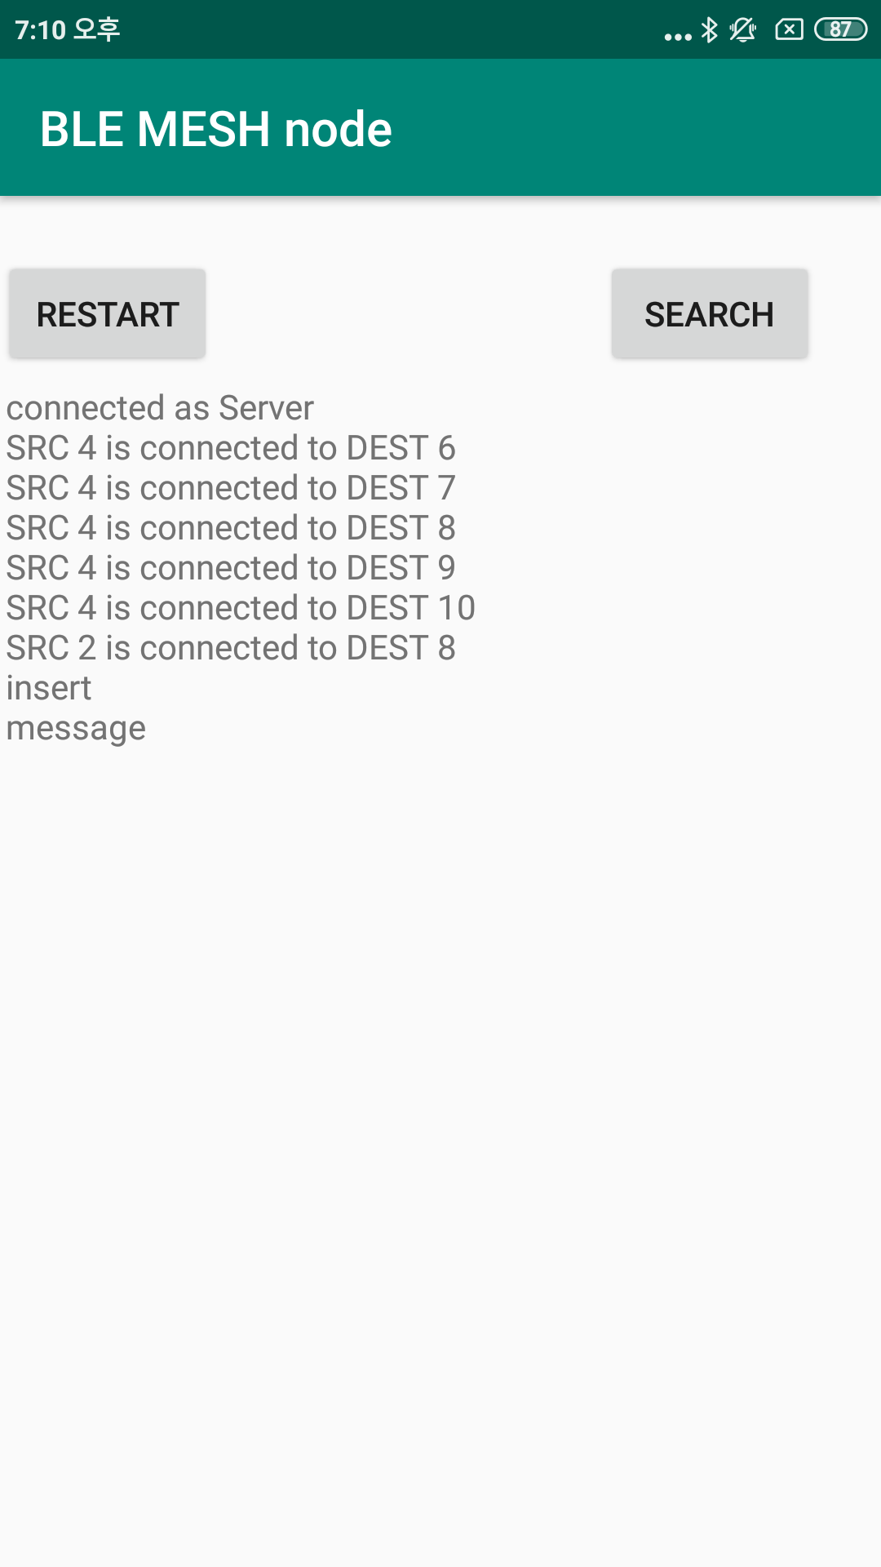
Developing Process
Before ESP device arrived, we used two smartphones, one is server and the other one is client
When client press button, then the information is sent to server smartphone.
Client Smartphone Device
Server Smartphone Device

Slide 22
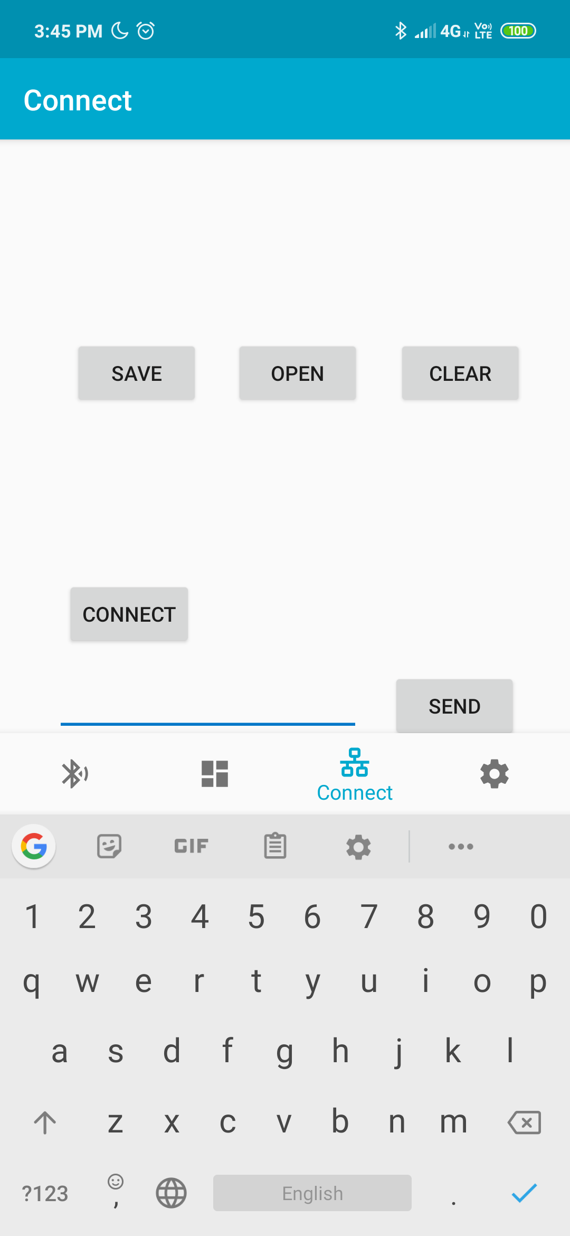

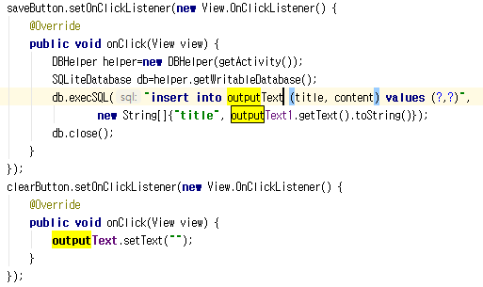
Developing Process
Internal DB instance is used.
Log screen is so small.
Although, there is scroll bar function too.
But it can clear screen and load again.
After clearing
After Loaded from DB

Slide 23
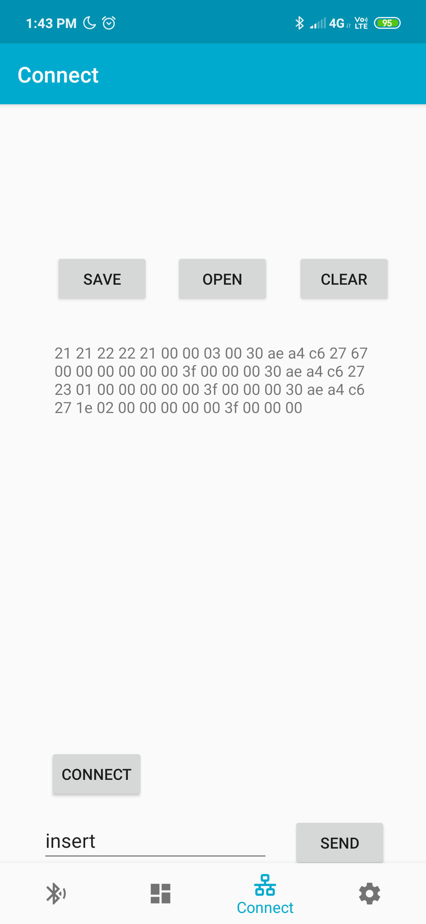
Operation Sequence
Click the ESP device
Press the connect button
Transmission log appears on the center.
Logs can be saved, loaded or cleared.
Users can operate manually by typing numbers and pressing sending button.

Slide 24
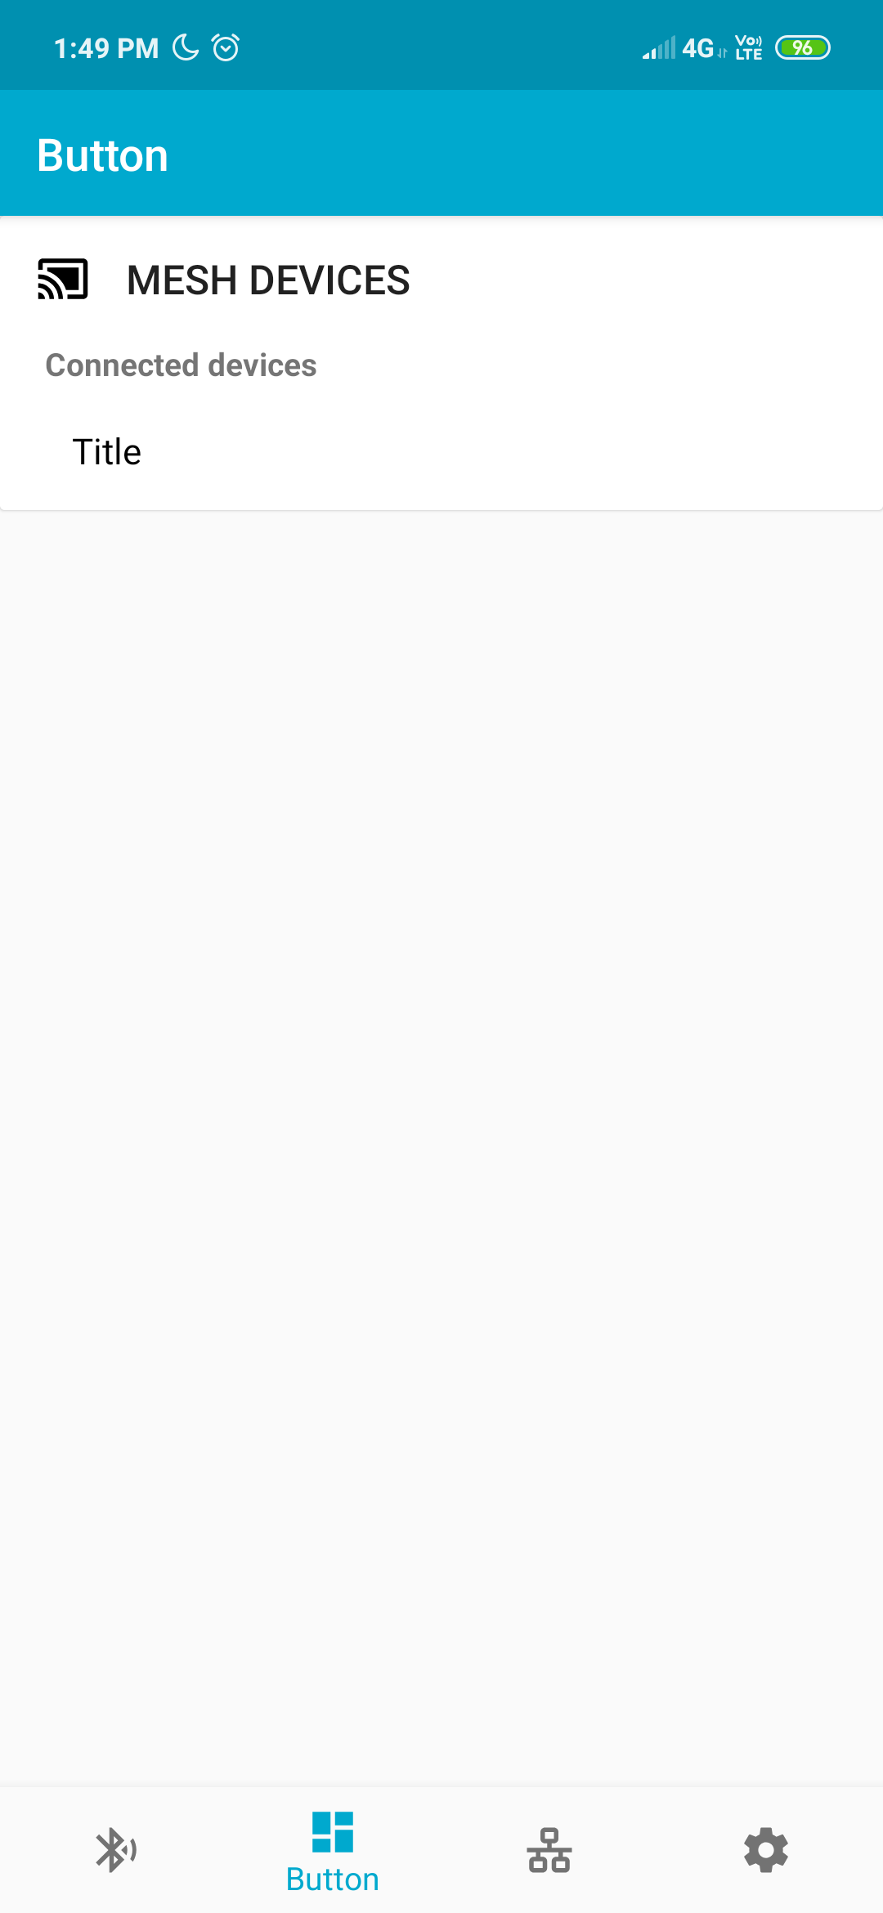
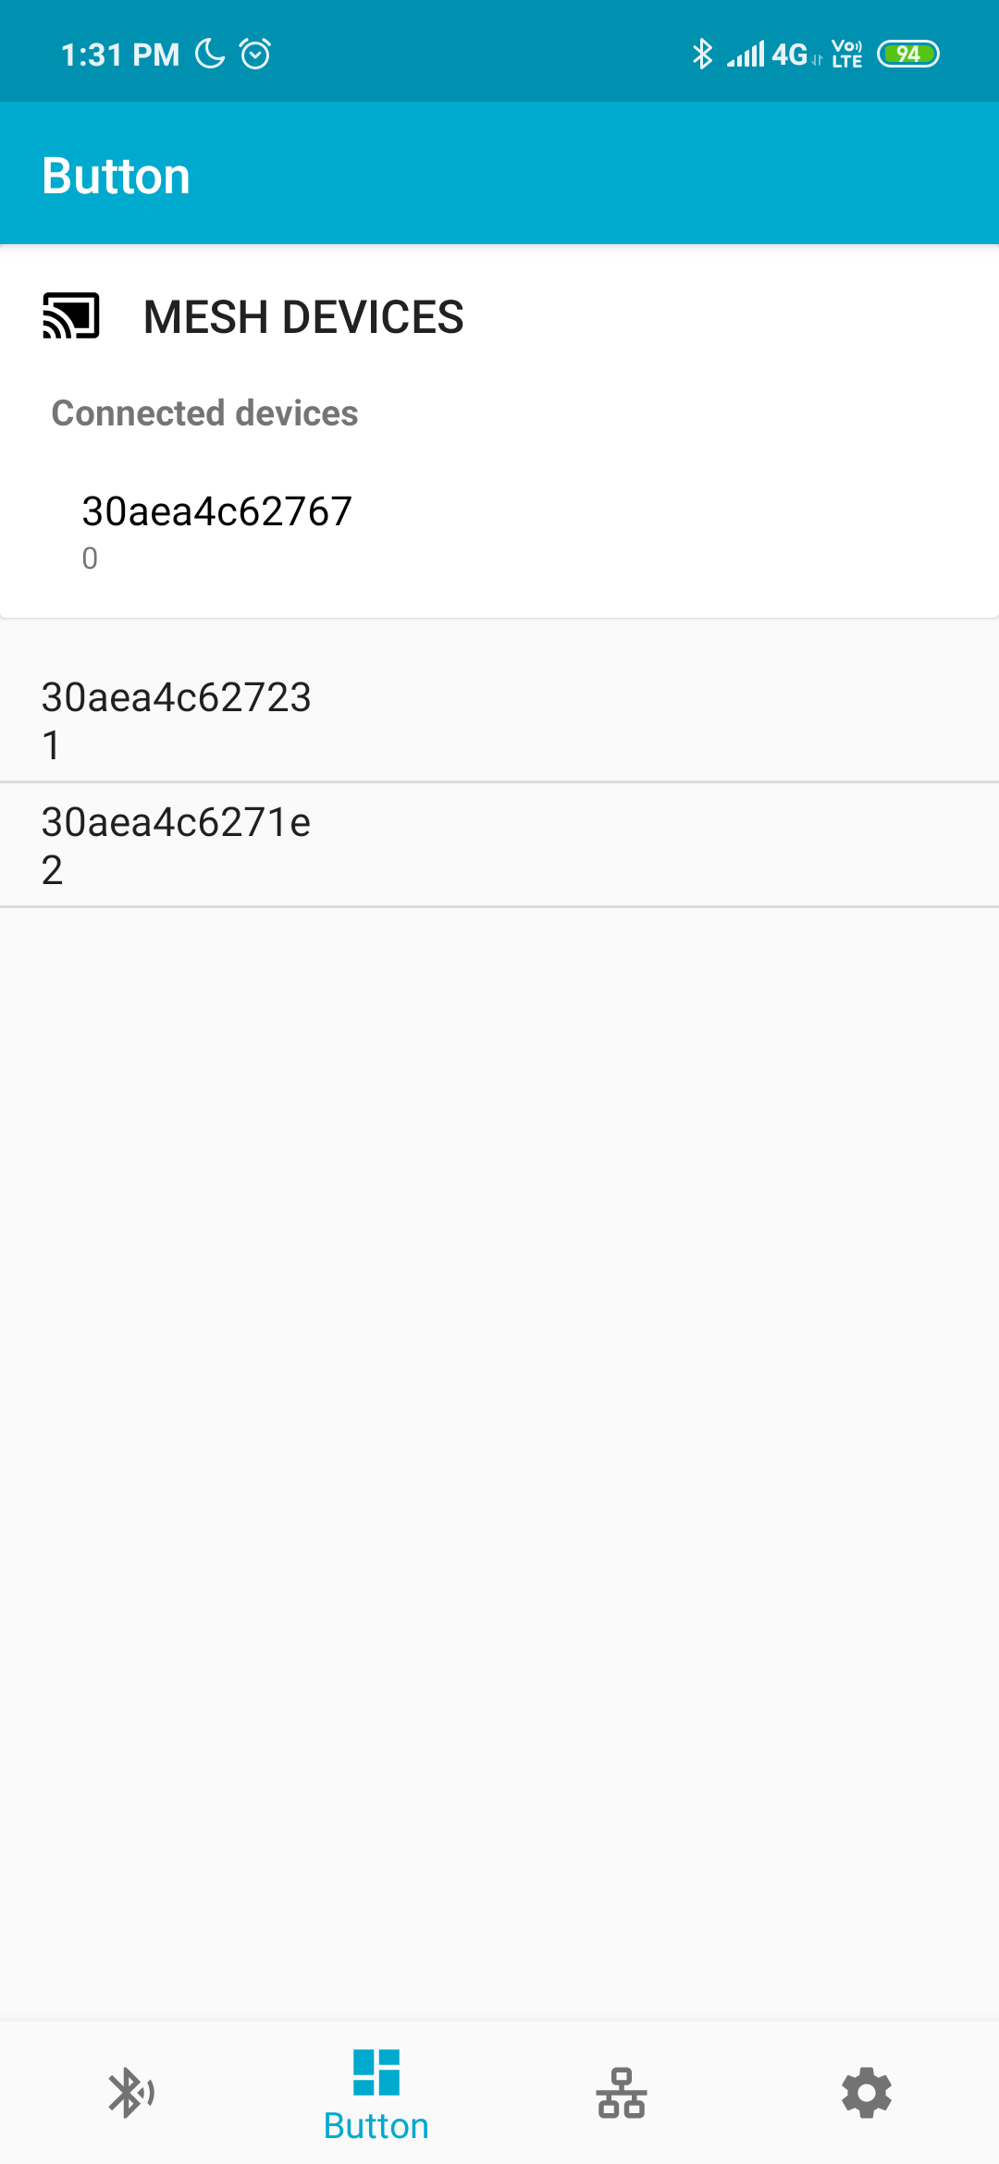
Operation Sequence
Before connected, there is not device list.
After connected with ESP device, Directly connected device appeared on the top.
Friend devices are under the directly connected device.

Slide 25
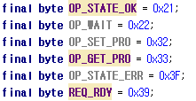
Instructions used for transmission
OP_STATE_OK recognizing other device’s condition.
OP_WAIT means current device is busy, so cannot process other function now.
OP_SET_PRO is set profile(PacketData or PakcetState), OP_GET_PRO is opposite one.
OP_STATE_ERR mean error occurs on current device.
REQ_RDY means current device is ready for process.

Slide 26
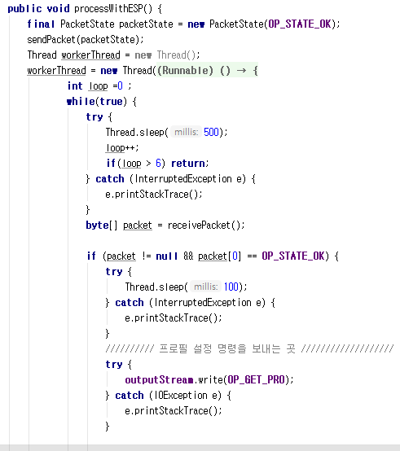
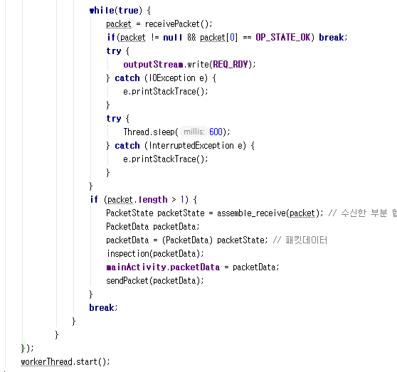
Transmission Process
When received OK then PacketData arrived.
Send OK from android
Continue sending RDY because android is ready to get
Receive from ESP
Assemble PacketData
and Send again
If OK from ESP then process
Get profile from ESP

Slide 27
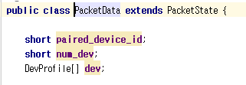
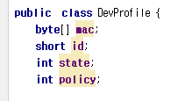
Class used for transmission
PackeData is Packet for transmission between ESP and Android Device.
DevProfile contains information for each device.
It is element of PacketData class.

Slide 28
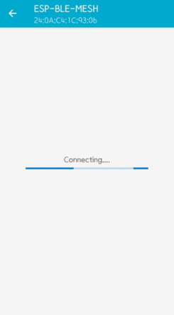
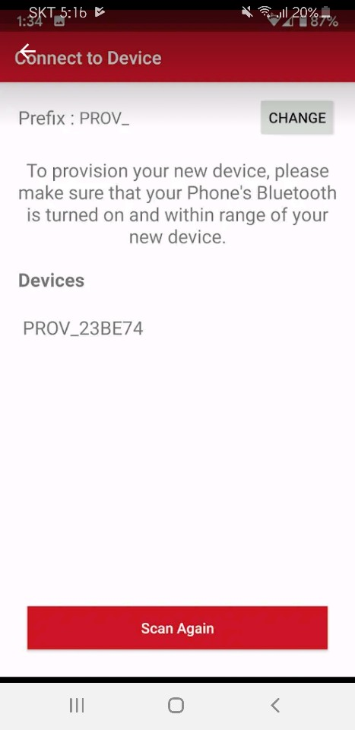
Trouble Shooting
We used similar app connecting with ESP device.
But in BLE mode, its connection is so unstable.
While in general mode, it can connect stably.

Slide 29
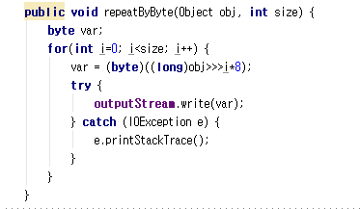
Trouble Shooting
At first, I sent each byte in turn. Not at one step.
Then ESP device occurs error.
SET_PROFILE instruction needs to be

Slide 30
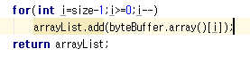
Trouble Shooting
Transmission between ESP is using Big endian.
For example, when we transmit integer variable, transmission sequence is like right one.
Each number represents each byte of integer.
Receive sequence is also same.
4
3
2
1
INT

Slide 31
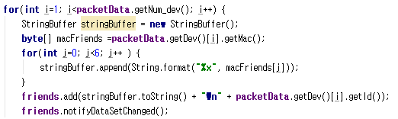
Trouble Shooting
When there is not notifyDataChanged() then DeviceListView will not appear.

Slide 32
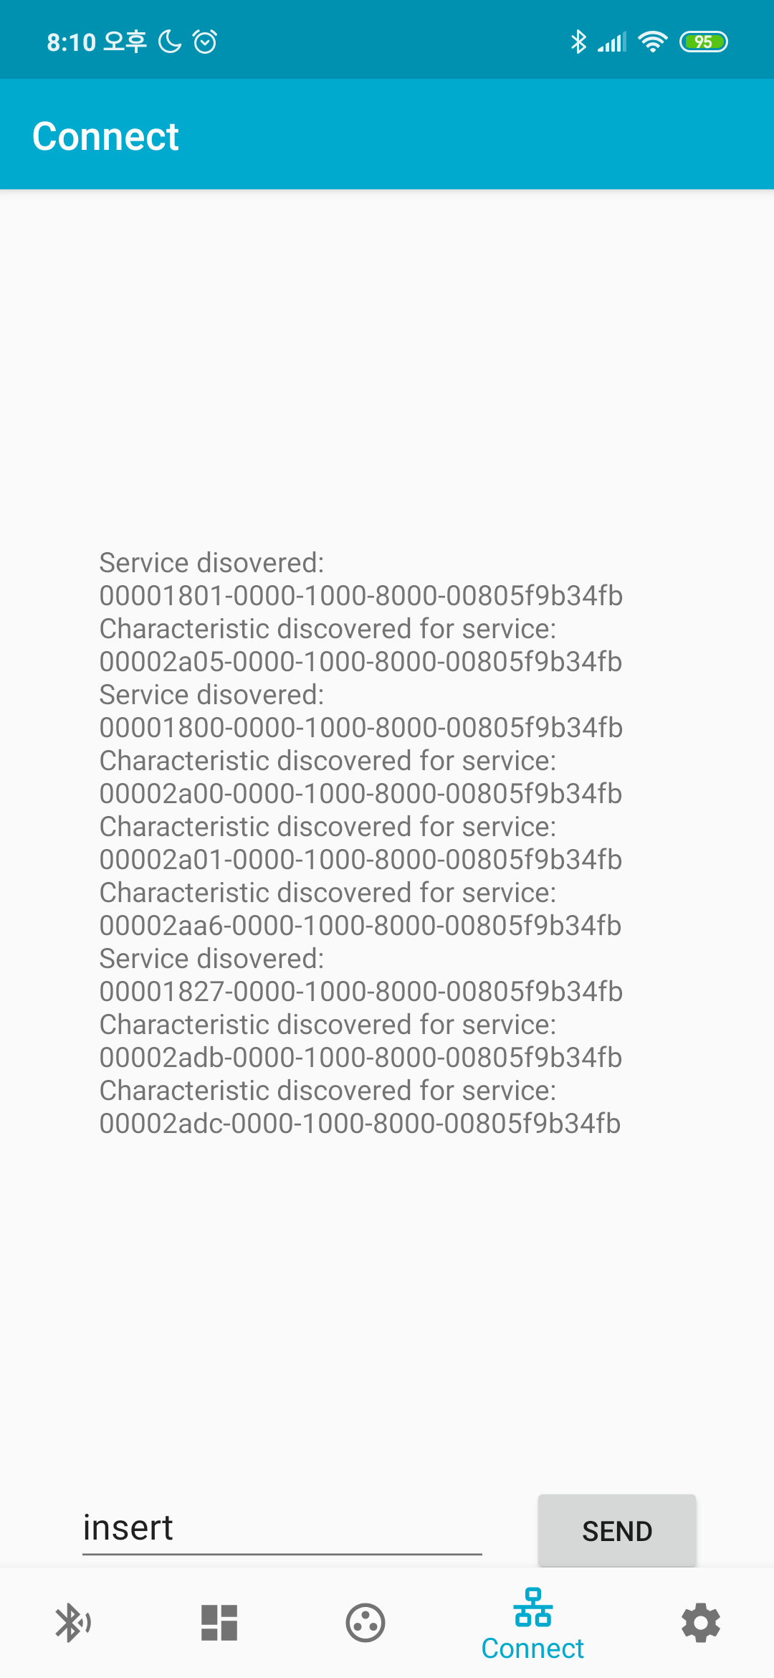
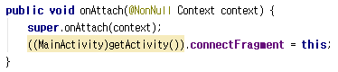
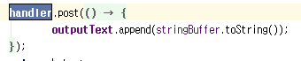
Trouble Shooting
At first, I didn’t used handler, then outputText is so unstable.
Handler is adjust operation between threads.
onAttach is the first step of fragment, when onAttach, we connect between fragments and the main activity.

Slide 33
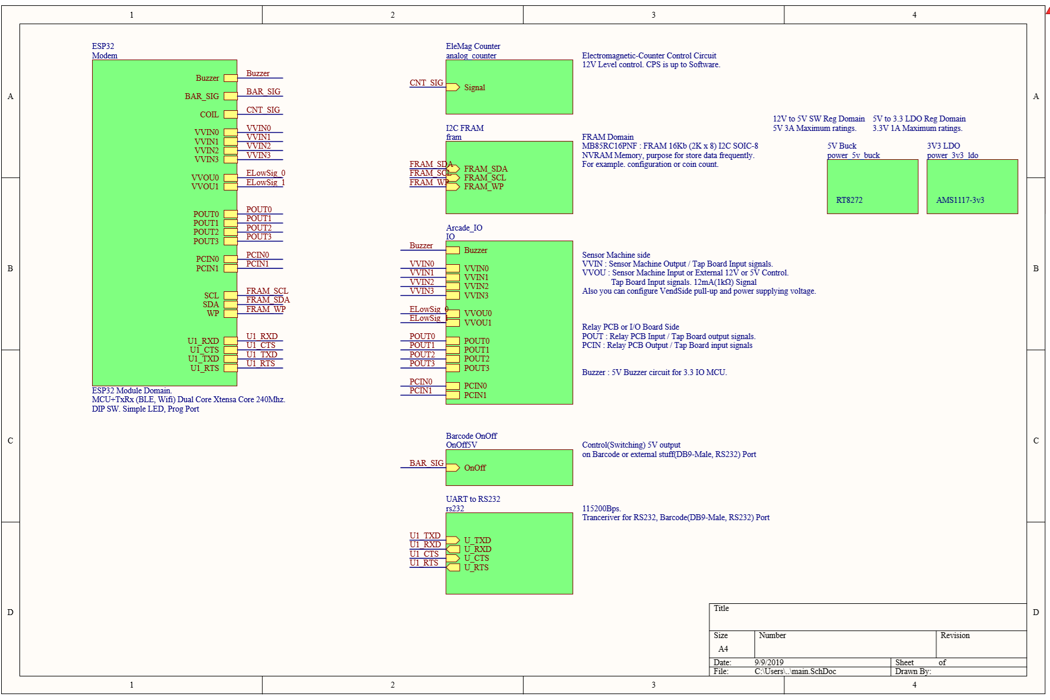
H.W Dev - Schematic

Slide 34
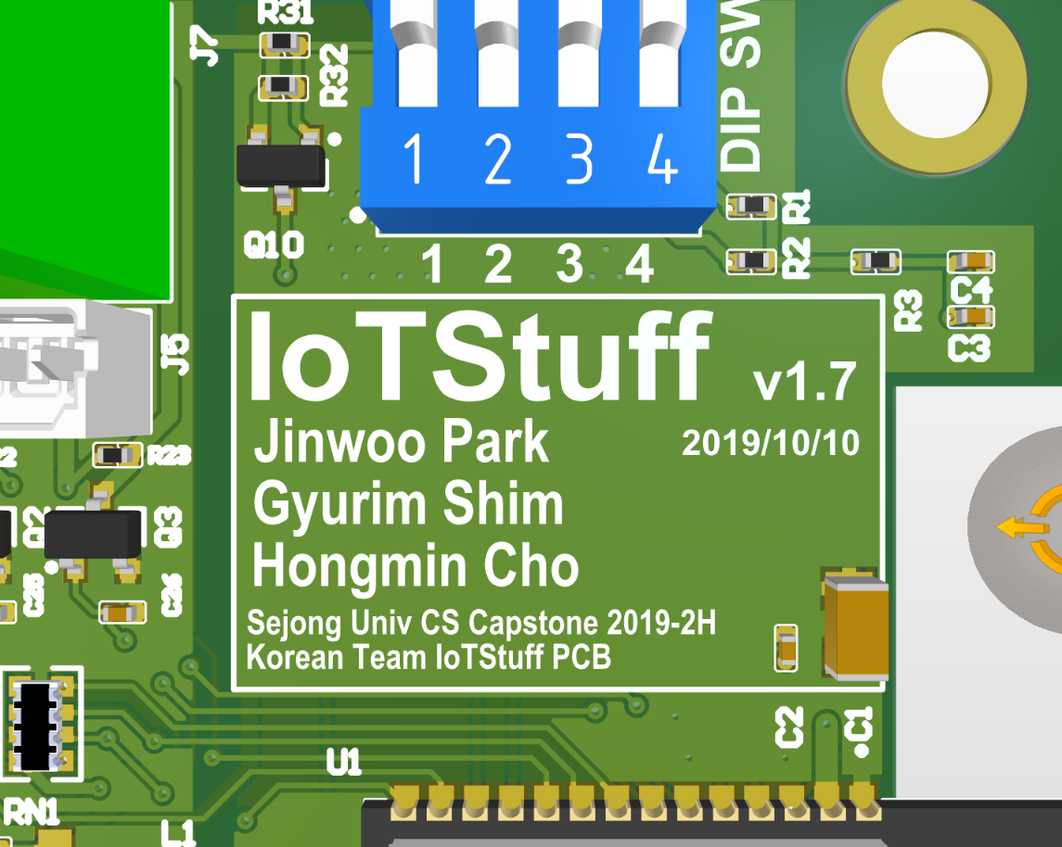
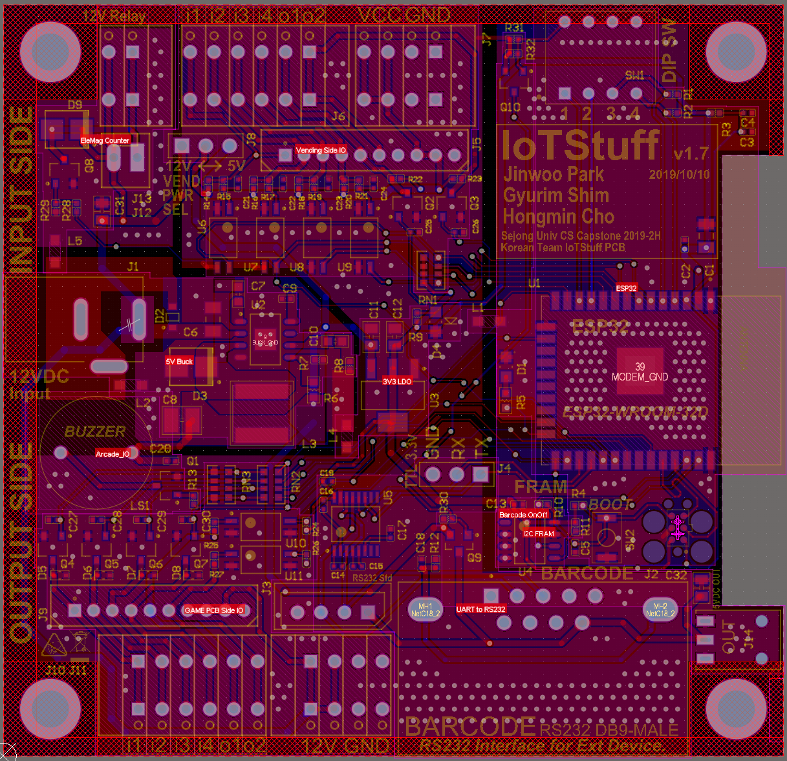
Gerber
Finished Gerber

Slide 35
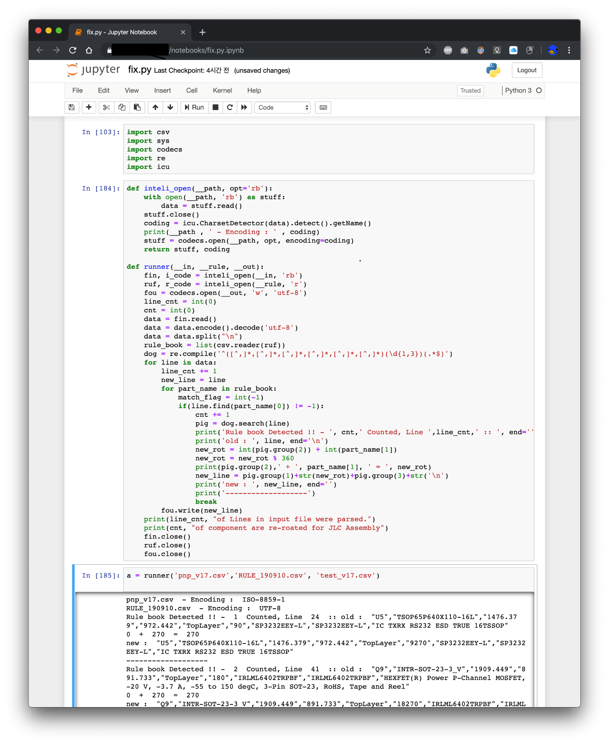
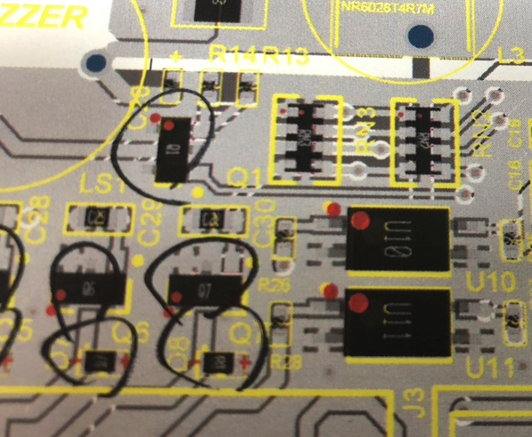
PCB Pick And Place works
PCB Pick And Place works
PCB’s Assembly data should be fix for each factory. Because Pick and Place is “How assembly parts” and robot arm rotate parts for pick and place on PCB. But PCB designer’s rotation rule and factory’s rule is different.
This is tricky issue. So I made script for fix it automatically with manual user own rule

Slide 36
PCB Pick And Place works – Result
Rotator PnP really helped for my PCB assembly
PCB factory accept my stuff very well.

Slide 37
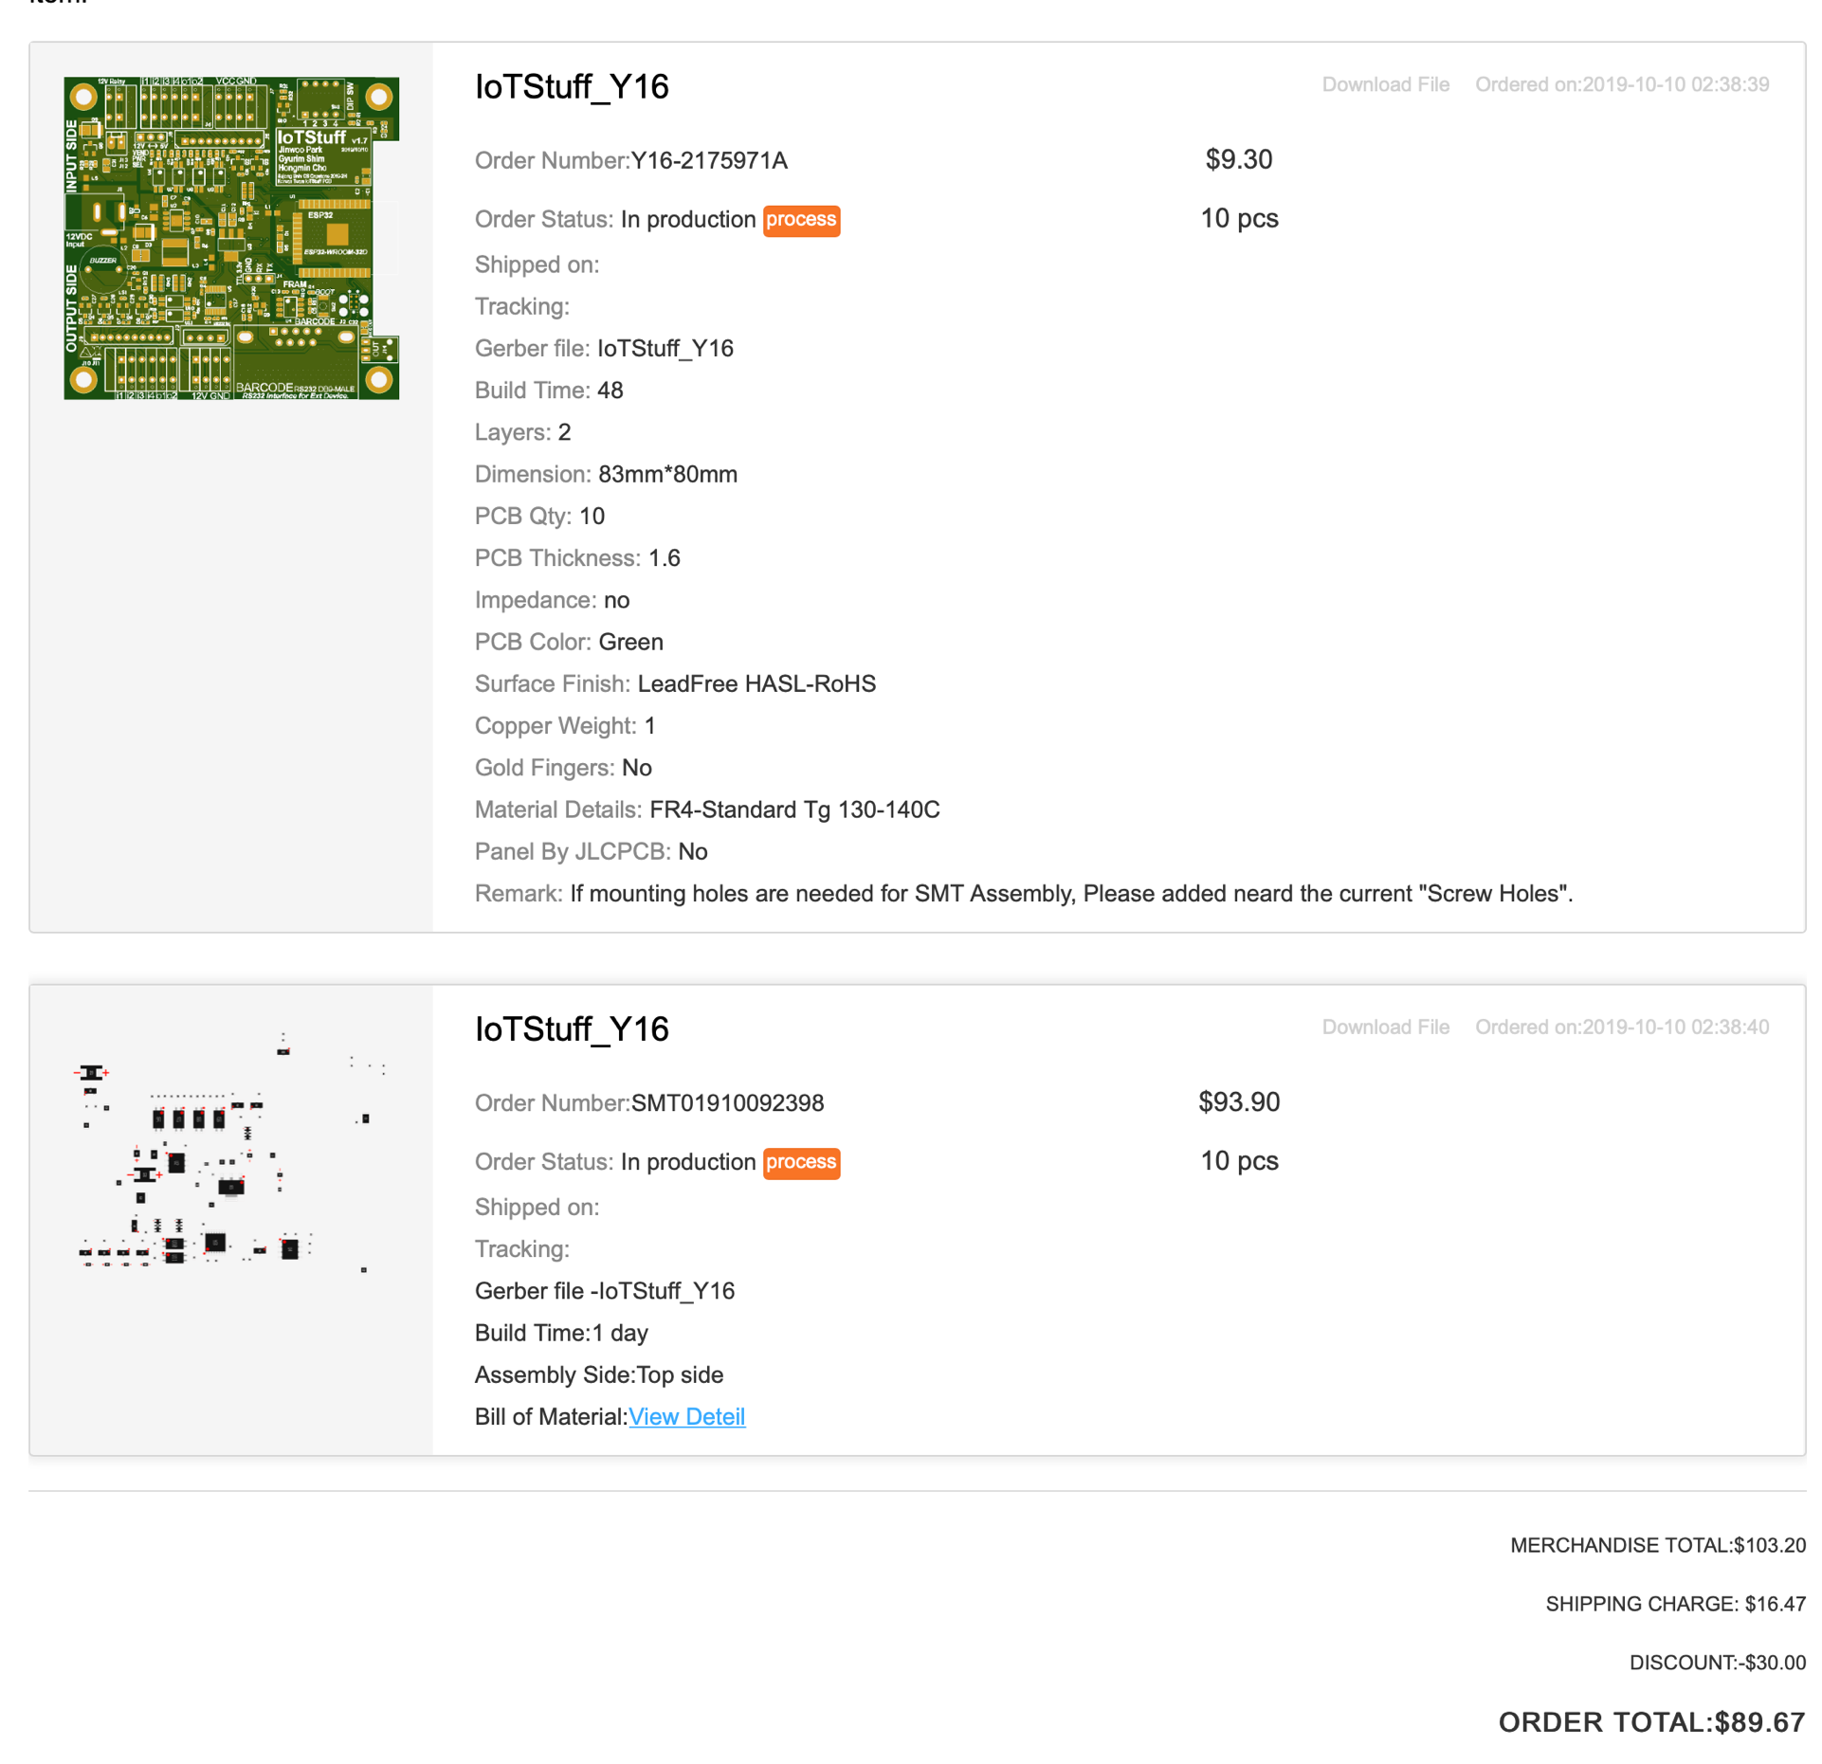
Hardware works - PCB Ordering
89 USD for 10 PCB
With Semi assemblied.
Remain components
MCU Module
Ports
Tact Switch

Slide 38
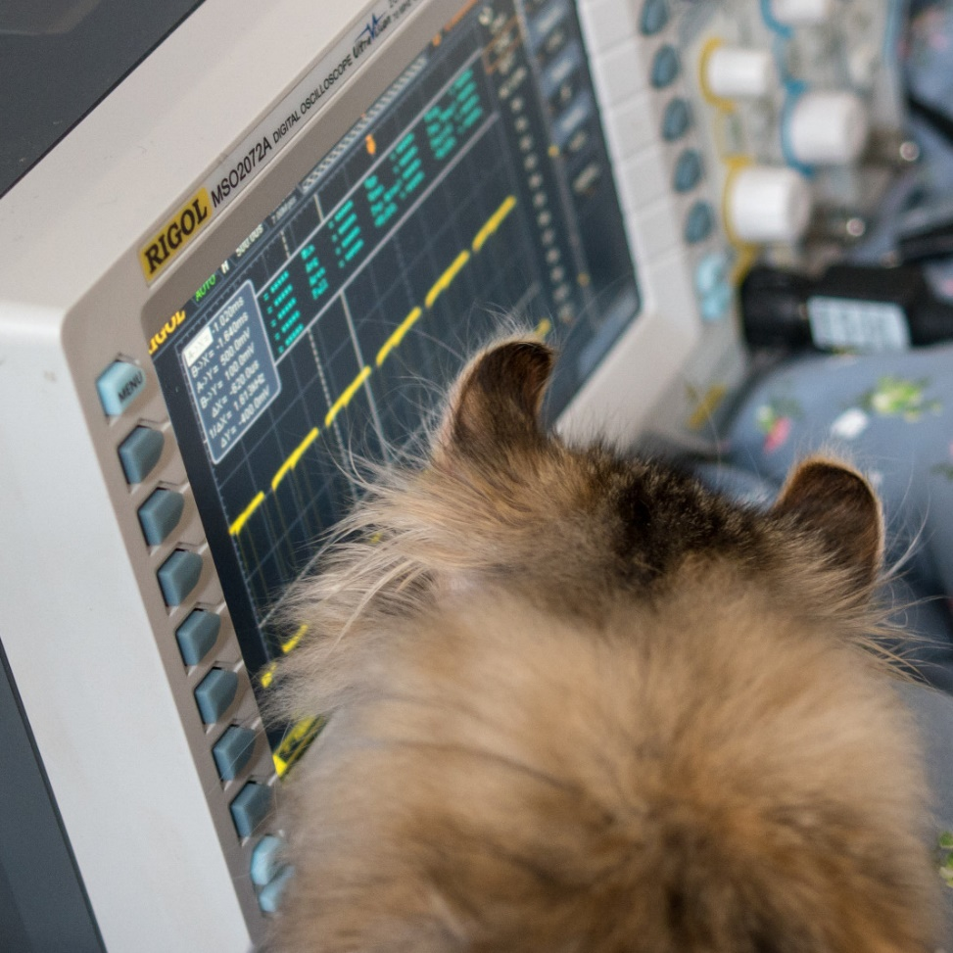
Another HW Debugging
Oscilloscope and pspice simulation.

Slide 39
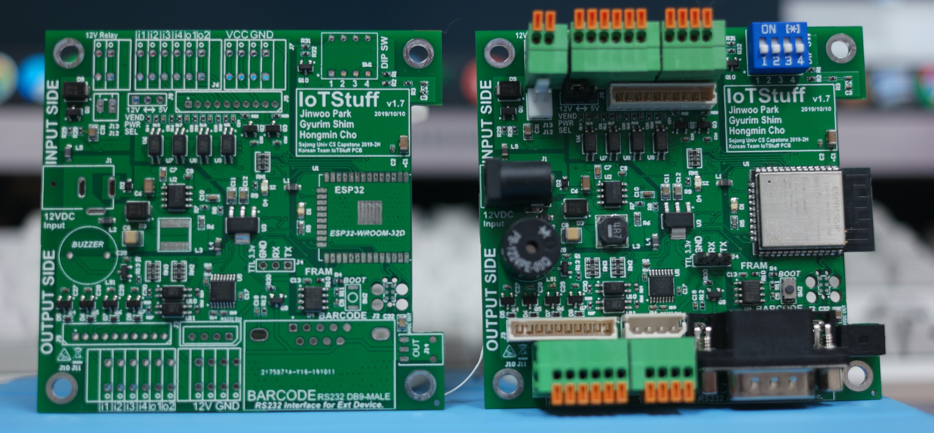
Hardware works – Final Assembly
Left : PCB Fab gave me with semi-assembled status.
Right : Assembled myself

Slide 40
Several attempt for network topology
BLE Mesh (First Time)
Fancy for Mesh topology , iOS app working with this but android app didn’t working well (even reference app too)
ESP-Wifi-Mesh (Second Time)
Better performance then BLE Mesh. In MCU side , it is impossible running BT Classic and Wifi Mesh together.
(Confused active and passive scanning in one 2.4Ghz RF H/W issue)
Wifi Mesh from Router Side.
Chip and Android is communicating with Bluetooth. And Chip is communicating with Router

Slide 41
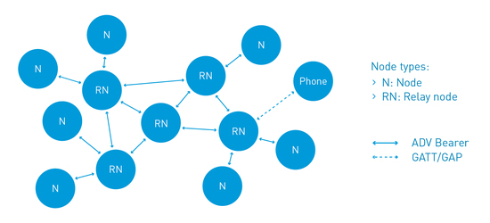
BLE Mesh

Slide 42
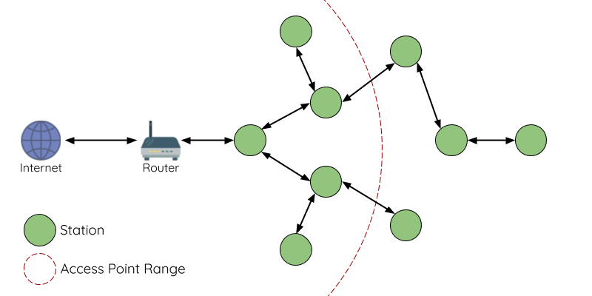
ESP-WIFI-MESH

Slide 43
WiFi Mesh (ESP-Mesh)
Wi-Fi Parent
ROUTER
ROUTER
Wi-Fi L1 Node
BT SPP
NODE
NODE
NODE
NODE
NODE
Wifi Router will be Parent Upstream.
Each routers communicate each other. And bridge each other.
Node connect to nearby router and possible to access any node in this group.
Node and Smart phone connected with Bluetooth Classic SPP.

Slide 44
WiFi Mesh (ESP-Mesh)
Wi-Fi Parent
ROUTER
ROUTER
Wi-Fi L1 Node
BT SPP
NODE
NODE
NODE
NODE
NODE
Wifi Router will be Parent Upstream.
Each routers communicate each other. And bridge each other.
Node connect to nearby router and possible to access any node in this group.
Node and Smart phone connected with Bluetooth Classic SPP.

Slide 45
Programming Side
Wi-Fi Parent
ROUTER
ROUTER
Wi-Fi L1 Node
BT SPP
NODE
NODE
NODE
NODE
NODE
Wifi Router will be Parent Upstream.
Each routers communicate each other. And bridge each other.
Node connect to nearby router and possible to access any node in this group.
Node and Smart phone connected with Bluetooth Classic SPP.

Slide 46
Programming Side
IoTStuff Firmware
bootloader
ESP-IDF
[ WiFi/BT Coexistence Stack ]
Classic BT SPP Acceptor
WiFi / BT Coexistence
WiFi Acceptor
GPIO Event Machine
Programming with FreeRTOS (Branch of xtensa core) and limited standard library C99
ESP32 is working with 240Mhz xtensa dual core. RTOS create task and scheduling very well. But need to use multi-core aware lock system for each process communication

Slide 47
Programming Side - Queue
Core 0
Core 1
RTOS
TCP Server
RTOS QUEUE
App
TCP Client
RTOS QUEUE
RTOS QUEUE
BT SPP
Each process communicate with queue system with queue.
Each task watch queue, if there’s new item. Do process.
ESP32 have 520Kybtes SRAM. Much more SRAM than any MCU. This make this simple queue system with many task.

Slide 48
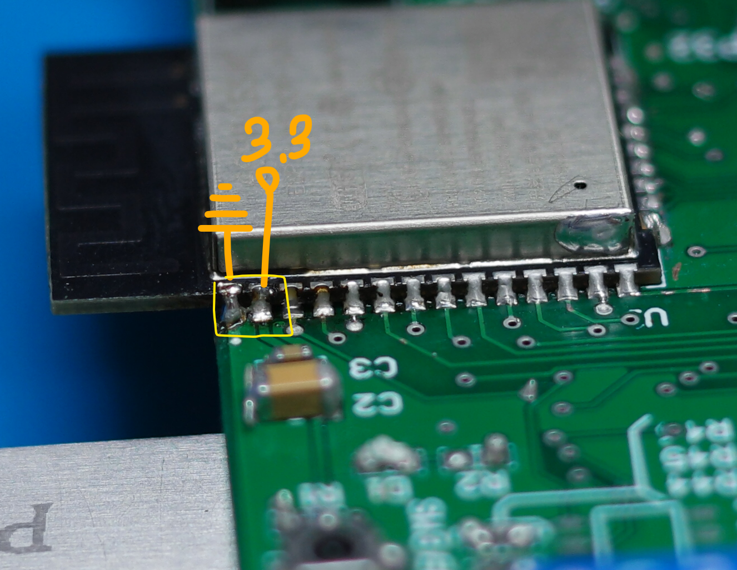
Conclusion
H/W develop is really hard. And consume many money first time.
ESP32 and first mesh protocol has no problem but Android implementation had issue with BLE MESH. So we waste too much time.
While assembly MCU Module by soldering thermal spread issue make VDD and VSS’s line closed (Very dangerous)

Slide 49


Future
If I design and renew this project ….
Using open Thread(Google Nest) with Nordic Semiconductor’s NRF52xxx chips.
Much faster and more stable than BLE Mesh.

Slide 50

Demonstration

Slide 51

Demonstration
4 Buttons and 4 LEDs
For demonstration of I/O

Slide 52











Demonstration
Dummy Node
Nearest _Node_
MESH NODE

Slide 53

Demonstration

